Slide 1
Software Engineering
Sara Rehmat
MS (CS)

Slide 2
Creational Patterns
Singleton
Factory
Abstract Factory

Slide 3
Singleton Pattern
Intent:
Singleton is a creational design pattern that lets you ensure that a class has only one instance, while providing a global access point to this instance.
Problem:
The Singleton pattern solves two problems at the same time, violating the Single Responsibility Principle:
Ensure that a class has just a single instance.
Control access to some shared resource—for example, a database or a file.
Imagine that you created an object, but after a while decided to create a new one. Instead of receiving a fresh object, you’ll get the one you already created.
This behavior is impossible to implement with a regular constructor since a constructor call must always return a new object by design.

Slide 4
Singleton Pattern - Problem
2. A global access point to that instance.
The object should be accessible from anywhere in the program but unlike a global variable, it must be protected from being overwritten by other code.

Slide 5
Singleton Pattern - Solution
All implementations of the Singleton have these two steps in common:
Make the default constructor private, to prevent other objects from using the new operator with the Singleton class.
Create a static creation method that acts as a constructor. This method calls the private constructor to create an object and saves it in a static field. All following calls to this method return the cached object.
If your code has access to the Singleton class, then it’s able to call the Singleton’s static method. So whenever that method is called, the same object is always returned.

Slide 6
Singleton Pattern
Real-world Analogy
The government is an excellent example of the Singleton pattern. A country can have only one official government. Regardless of the personal identities of the individuals who form governments, the title, “The Government of X”, is a global point of access that identifies the group of people in charge.

Slide 7
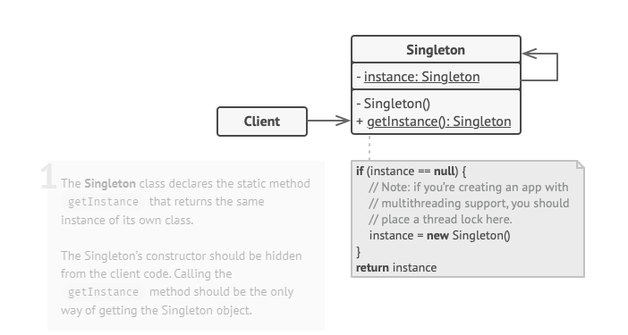
Singleton Pattern
Structure:

Slide 8
Singleton Pattern
Pseudocode
In this example, the database connection class acts as a Singleton.

Slide 9
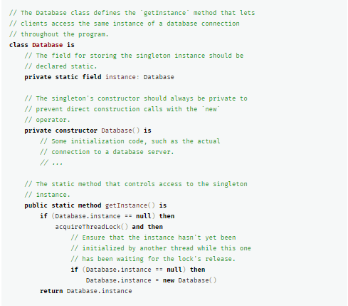

Slide 10
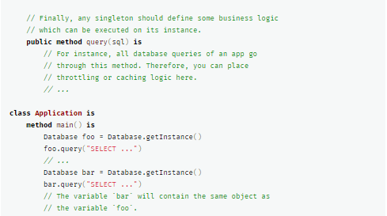

Slide 11
Singleton Pattern
How to implement
Add a private static field to the class for storing the singleton instance.
Declare a public static creation method for getting the singleton instance.
Implement “lazy initialization” inside the static method. It should create a new object on its first call and put it into the static field. The method should always return that instance on all subsequent calls.
Make the constructor of the class private. The static method of the class will still be able to call the constructor, but not the other objects.
Go over the client code and replace all direct calls to the singleton’s constructor with calls to its static creation method.

Slide 12
Singleton Pattern
Applicability:
Use the Singleton pattern when a class in your program should have just a single instance available to all clients; for example, a single database object shared by different parts of the program.
Use the Singleton pattern when you need stricter control over global variables.

Slide 13
Singleton Pattern
Pros:
You can be sure that a class has only a single instance.
You gain a global access point to that instance.
The singleton object is initialized only when it’s requested for the first time.

Slide 14
Singleton Pattern
Cons
Violates the Single Responsibility Principle. The pattern solves two problems at the time.
The pattern requires special treatment in a multithreaded environment so that multiple threads won’t create a singleton object several times.

Slide 15
Factory Pattern
Intent
Factory Method is a creational design pattern that provides an interface for creating objects in a superclass, but allows subclasses to alter the type of objects that will be created.

Slide 16
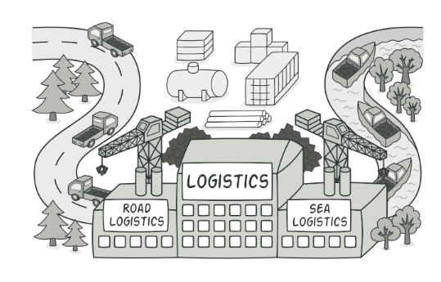
Factory Pattern - Problem
Imagine that you’re creating a logistics management application.
The first version of your app can only handle transportation by trucks, so the bulk of your code lives inside the Truck class.
After a while, your app becomes pretty popular. Each day you receive dozens of requests from sea transportation companies to incorporate sea logistics into the app.

Slide 17
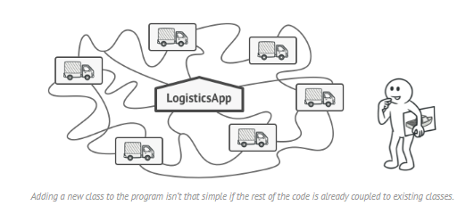
Factory Pattern - Problem
At present, most of your code is coupled to the Truck class. Adding Ships into the app would require making changes to the entire codebase. Moreover, if later you decide to add another type of transportation to the app, you will probably need to make all of these changes again.
As a result, you will end up with pretty nasty code, riddled with conditionals that switch the app’s behavior depending on the class of transportation objects.

Slide 18
Factory Pattern - Solution
The Factory Method pattern suggests that you replace direct object construction calls (using the new operator) with calls to a special factory method.
The objects are still created via the new operator, but it’s being called from within the factory method. Objects returned by a factory method are often referred to as “products.”

Slide 19
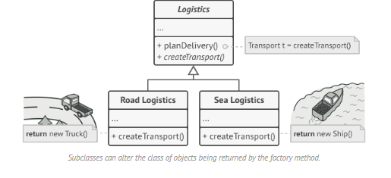
Factory Pattern - Solution

Slide 20
Factory Pattern - Solution
We moved the constructor call from one part of the program to another.
Now you can override the factory method in a subclass and change the class of products being created by the method.
There’s a slight limitation though:
Subclasses may return different types of products only if these products have a common base class or interface.
Also, the factory method in the base class should have its return type declared as this interface.

Slide 21
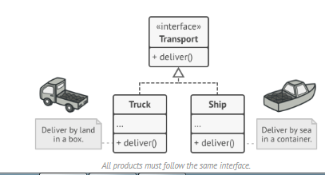
Factory Pattern - Solution
For example, both Truck and Ship classes should implement the Transport interface, which declares a method called deliver.
Each class implements this method differently: trucks deliver cargo by land, ships deliver cargo by sea. The factory method in the RoadLogistics class returns truck objects, whereas the factory method in the SeaLogistics class returns ships.

Slide 22
Factory Pattern - Solution
The code that uses the factory method (often called the client code) doesn’t see a difference between the actual products returned by various subclasses.
The client treats all the products as abstract Transport. The client knows that all transport objects are supposed to have the deliver method, but exactly how it works isn’t important to the client.

Slide 23
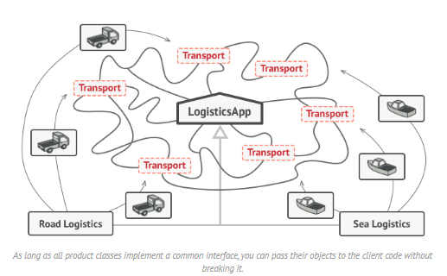
Factory Pattern

Slide 24
Factory Pattern - Pseudocode
This example illustrates how the Factory Method can be used for creating cross-platform UI elements without coupling the client code to concrete UI classes.

Slide 25
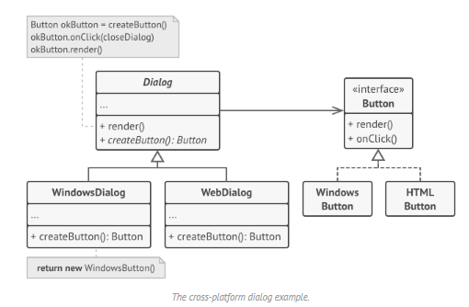
Factory Pattern - Pseudocode
The base dialog class uses different UI elements to render its window.
Under various operating systems, these elements may look a little bit different,
but they should still behave consistently. A button in Windows is still a button in Linux.

Slide 26
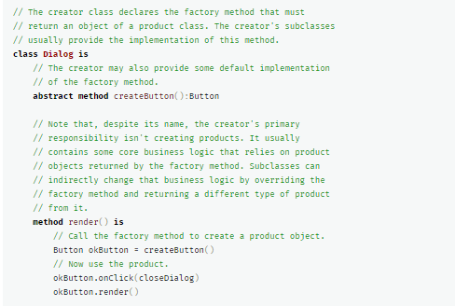
Factory Pattern - Pseudocode

Slide 27
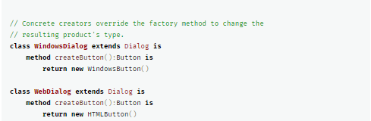
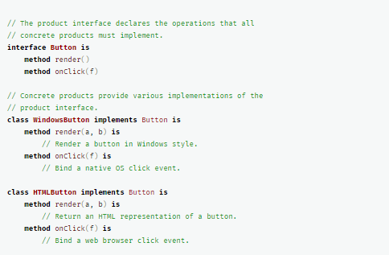

Slide 28
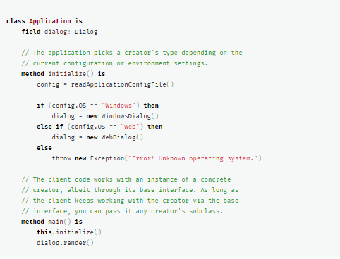

Slide 29
Factory Pattern - Applicability
Use the Factory Method when you don’t know beforehand the exact types and dependencies of the objects your code should work with.
Use the Factory Method when you want to provide users of your library or framework with a way to extend its internal components.
Use the Factory Method when you want to save system resources by reusing existing objects instead of rebuilding them each time.

Slide 30
Factory Pattern - Pros
You avoid tight coupling between the creator and the concrete products.
Single Responsibility Principle. You can move the product creation code into one place in the program, making the code easier to support.
Open/Closed Principle. You can introduce new types of products into the program without breaking existing client code.

Slide 31
Factory Pattern - Cons
The code may become more complicated since you need to introduce a lot of new subclasses to implement the pattern. The best case scenario is when you’re introducing the pattern into an existing hierarchy of creator classes.

Slide 32
Abstract Factory Pattern - Intent
Abstract Factory is a creational design pattern that lets you produce families of related objects without specifying their concrete classes.

Slide 33
Abstract Factory Pattern - Problem
Imagine that you’re creating a furniture shop simulator. Your code consists of classes that represent: A family of related products, say:
Chair, Sofa, CoffeeTable.
Several variants of this family. For example, products Chair, Sofa , CoffeeTable are available in these variants: Modern, Victorian, ArtDeco.
You need a way to create individual furniture objects so that they match other objects of the same family. Customers get quite mad when they receive non-matching furniture.
Also, you don’t want to change existing code when adding new products or families of products to the program. Furniture vendors update their catalogs very often, and you wouldn’t want to change the core code each time it happens.

Slide 34
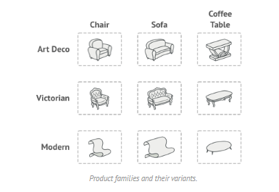
Abstract Factory Pattern - Problem

Slide 35
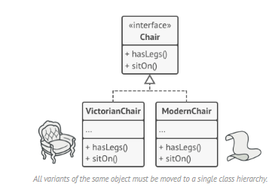
Abstract Factory Pattern - Solution
The first thing the Abstract Factory pattern suggests is to explicitly declare interfaces for each distinct product of the product family (e.g., chair, sofa or coffee table).
Then you can make all variants of products follow those interfaces. For example, all chair variants can implement the Chair interface; all coffee table variants can implement the CoffeeTable interface, and so on.

Slide 36
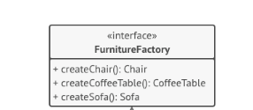
Abstract Factory Pattern - Solution
The next move is to declare the Abstract Factory—an interface with a list of creation methods for all products that are part of the product family (for example, createChair, createSofa and createCoffeeTable).
These methods must return abstract product types represented by the interfaces we extracted previously: Chair, Sofa, CoffeeTable and so on.

Slide 37
Abstract Factory Pattern - Solution
For each variant of a product family, we create a separate factory class based on the AbstractFactory interface.
A factory is a class that returns products of a particular kind. For example, the ModernFurnitureFactory can only create ModernChair, ModernSofa and ModernCoffeeTable objects.
The client code has to work with both factories and products via their respective abstract interfaces.
This lets you change the type of a factory that you pass to the client code, as well as the product variant that the client code receives, without breaking the actual client code.

Slide 38
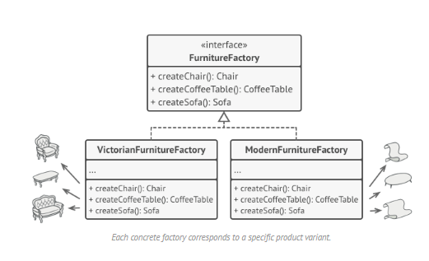
Abstract Factory Pattern - Solution

Slide 39
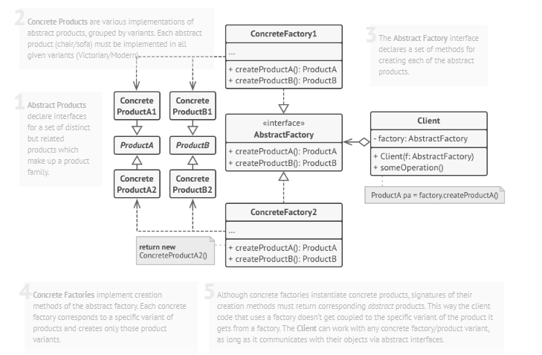
Abstract Factory Pattern - Structure

Slide 40
Abstract Factory Pattern - Pseudocode
This example illustrates how the Abstract Factory pattern can be used for creating cross-platform UI elements without coupling the client code to concrete UI classes, while keeping all created elements consistent with a selected operating system.

Slide 41
Abstract Factory Pattern – Applicability
Use the Abstract Factory when your code needs to work with various families of related products, but you don’t want it to depend on the concrete classes of those products—they might be unknown beforehand or you simply want to allow for future extensibility.

Slide 42
Abstract Factory Pattern – Implementation Steps
Map out a matrix of distinct product types versus variants of these products.
Declare abstract product interfaces for all product types. Then make all concrete product classes implement these interfaces.
Declare the abstract factory interface with a set of creation methods for all abstract products.
Implement a set of concrete factory classes, one for each product variant.
Create factory initialization code somewhere in the app. It should instantiate one of the concrete factory classes, depending on the application configuration or the current environment. Pass this factory object to all classes that construct products.
Scan through the code and find all direct calls to product constructors. Replace them with calls to the appropriate creation method on the factory object.

Slide 43
Abstract Factory Pattern - Pros
You can be sure that the products you’re getting from a factory are compatible with each other.
You avoid tight coupling between concrete products and client code.
Single Responsibility Principle. You can extract the product creation code into one place, making the code easier to support.
Open/Closed Principle. You can introduce new variants of products without breaking existing client code.

Slide 44
Abstract Factory Pattern - Cons
The code may become more complicated than it should be, since a lot of new interfaces and classes are introduced along with the pattern.

Slide 45
References
https://refactoring.guru/design-patterns

